Slide 1
HCF or LCM
Properties of number: factors, multiples, squares and cubes

Slide 2
how to use Oak lessons

Slide 3
I can use the prime factorisation of two or more positive integers to efficiently find either the highest common factor or lowest common multiple, depending on the context of the question.

Slide 4
HCF is an abbreviation for highest common factor.
LCM is an abbreviation for lowest common multiple.

Slide 5

HCF or LCM
HCF in a context
LCM in a context
Whether to use HCF or LCM based on the context

Slide 6
HCF in a context
Group A has 30 students
Group B as 42 students
They need to get into the largest teams they can but each group must have the same number in each team.
Factors of 30
Factors of 42
1 × 30
1 × 42
2 × 15
2 × 21
3 × 10
3 × 14
5 × 6
6 × 7
The largest teams they can get into is 6.

Slide 7
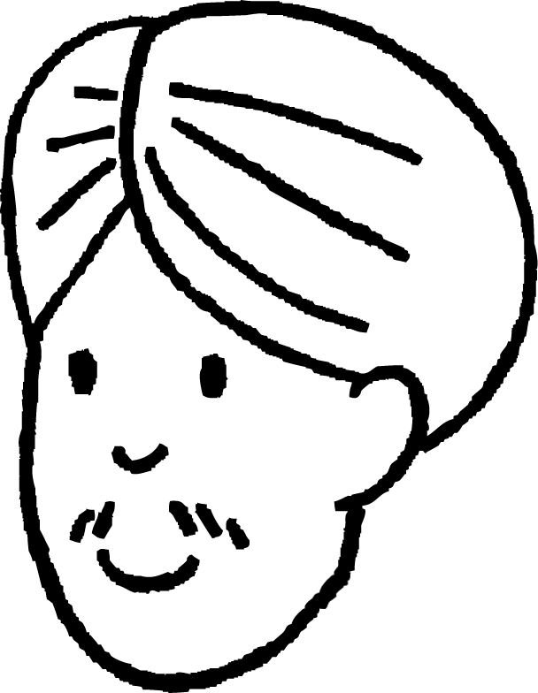
HCF in a context
Andeep has two lengths of ribbon.
315 cm
240 cm
He needs to cut them in to the longest equal strips he can with no waste.
What is the longest length of ribbon he can make?
Prime factors of 315
Prime factors of 240
315 = 3² × 5 × 7
3
3
2⁴
240 = 2⁴ × 3 × 5
5
7
The longest length of ribbon is 15 cm. The product of the intersection.

Slide 8
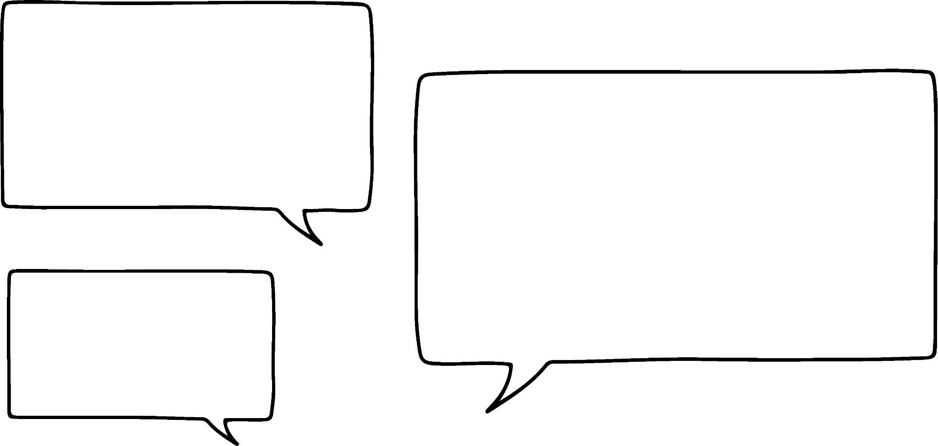

HCF in a context
Sofia is working out the HCF of 35 & 45.
Without doing any calculations decide how you know Sofia must be wrong.
I’ve drawn a Venn diagram and the HCF of 35 & 45 is 315.
A factor of a number cannot be greater than the number itself.
So the HCF cannot be greater than 35 in this case.

Slide 9
HCF in a context
1) Aisha’s little brother is sorting his 30 cars and 50 bricks into equal rows. What is the maximum number in each row if there are no rows with both cars and bricks?

Slide 10
HCF in a context
2) Jacob has 24 white, 42 red and 48 yellow flowers. What is the greatest number of identical bunches he can make that uses all of the flowers?

Slide 11
HCF in a context
3) Lucas is making a model. He needs to cut his wire into the longest equal lengths possible. One piece is 420 cm and the other is 120 cm. How long can he make each piece?

Slide 12
HCF in a context
1) Aisha’s little brother is sorting his 30 cars and 50 bricks into equal rows. What is the maximum number in each row if there are no rows with both cars and bricks?
30 = 2 × 3 × 5
50 = 2 × 5²
HCF = 2 × 5 = 10

Slide 13
HCF in a context
2) Jacob has 24 white, 42 red and 48 yellow flowers. What is the greatest number of identical bunches he can make that uses all of the flowers?
24 = 2³ × 3
42 = 2 × 3 × 7
48 = 2⁴ × 3
HCF = 2 × 3 = 6

Slide 14
HCF in a context
3) Lucas is making a model. He needs to cut his wire into the longest equal lengths possible. One piece is 420 cm and the other is 120 cm. How long can he make each piece?
420 = 2² × 3 × 5 × 7
120 = 2³ × 3 × 5
HCF = 2² × 3 × 5 = 60

Slide 15
HCF or LCM
HCF in a context
LCM in a context
Whether to use HCF or LCM based on the context

Slide 16




LCM in a context
Alex, Sam and Laura are making daisy chains.
3 cm
6 cm
9 cm
12 cm
15 cm
18 cm
21 cm
24 cm
27 cm
30 cm
5 cm
10 cm
15 cm
20 cm
25 cm
30 cm
6 cm
12 cm
18 cm
24 cm
30 cm
They want to make them the same length. How long will the chains be?
The shortest daisy chain would be 30 cm.

Slide 17
LCM in a context
Izzy is splitting her stickers into smaller groups.
She can make groups of 10, 12 and 28 with none left over.
What is the smallest number of stickers she has?
Prime factors of 10
Prime factors of 12
10 = 2 × 5
5
3
2
12 = 2² × 3
2
28 = 2² × 7
7
Prime factors of 28
The smallest number of stickers she can have is 420.

Slide 18


LCM in a context
Which Venn diagram and answer is correct for the LCM of 2³ × 3² × 5² and 2² × 3³ × 5
2²
2
2
2²
2²
2
2
3²
3²
3
3²
3
5
3
5
5
5
5
5
2⁴ × 3³ × 5² = 10 800
2² × 3² × 5 = 180
2³ × 3³ × 5² = 5400
a
b
c

Slide 19
LCM in context
1) Jun goes swimming every 4 days and he goes to the cinema every 15 days. Which is the first day that he does both?

Slide 20
LCM in context
2) Jacob is baking he can bake 12 cupcakes and 20 biscuits at a time. He needs to make the same number of each. What is the smallest amount he can make?

Slide 21
LCM in context
3) Sam was making sandwiches for a party. Bread comes in loaves of 24 slices, cheese in packs of 15 slices and ham in packs of 40 slices. Each sandwich has 2 slices of bread and 1 slice of cheese and ham. What is the fewest of each she needs to buy to ensure no wastage?

Slide 22
LCM in context
1) Jun goes swimming every 4 days and he goes to the cinema every 15 days. Which is the first day that he does both?
4 = 2²,
15 = 3 × 5,
LCM = 2² × 3 × 5 = 60
The first day he does both is the 60th day

Slide 23
LCM in context
2) Jacob is baking he can bake 12 cupcakes and 20 biscuits at a time. He needs to make the same number of each. What is the smallest amount he can make?
12 = 2² × 3,
20 = 2² × 5,
LCM = 2² × 3 × 5 = 60
The smallest amount he can make is 60 of each

Slide 24
LCM in context
3) Sam was making sandwiches for a party. Bread comes in loaves of 24 slices, cheese in packs of 15 slices and ham in packs of 40 slices. Each sandwich has 2 slices of bread and 1 slice of cheese and ham. What is the fewest of each she needs to buy to ensure no wastage?
Each sandwich uses 2 slices of bread so you can make 12 from 1 loaf.
12 = 2² × 3,
15 = 3 × 5,
40 = 2³ × 5,
LCM = 2³ × 3 × 5 = 120
Sam has to buy 120 of each item.

Slide 25
HCF or LCM
HCF in a context
LCM in a context
Whether to use HCF or LCM based on the context

Slide 26
Whether to use HCF or LCM based on the context
Oak Academy are having a fete.
They are going to sell hotdogs.
Sausages come in packs of 12 and rolls in packs of 9.
They don’t want any leftovers.
What is the smallest number of hotdogs they can make?
12 = 2² × 3
Prime factors of 12
Prime factors of 9
2
9 = 3²
2
3
3
Do they need the HCF or LCM?
They will be buying multiple packs.
The LCM is 2 × 2 × 3 × 3 = 36

Slide 27
Whether to use HCF or LCM based on the context
Two schools are on a trip.
They need get the students across a lake in boats.
Without mixing the schools and making sure the groups are the same size.
What is the smallest number of crossings needed?
School A
120
School B
156
120 = 2³ × 3 × 5
Prime factors of 120
Prime factors of 156
156 = 2² × 3 × 13
2
2²
13
Do they need the HCF or LCM?
5
3
They will be splitting the students into smaller groups.
The HCF is 2² × 3 = 12

Slide 28
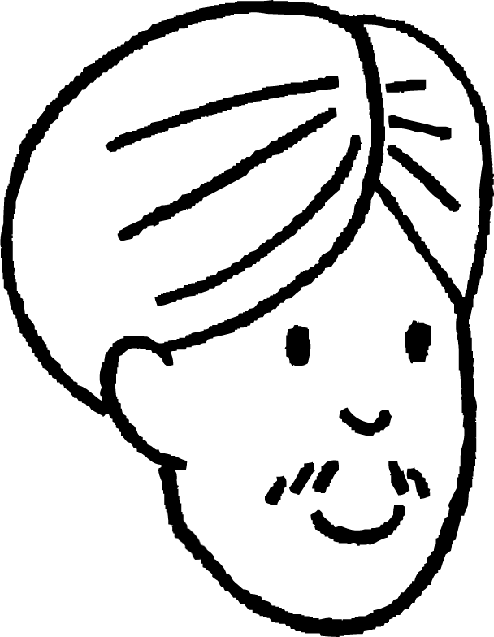
Whether to use HCF or LCM based on the context
Andeep is making bracelets. He wants each one to be the same.
He has 24 red beads, 32 yellow beads and 50 white beads.
To work this out I need to find the LCM.
No, he needs to work out the HCF. The LCM would mean increasing the number of beads.
He needs to split them into smaller groups.

Slide 29
Whether to use HCF or LCM based on the context
Decide if you would be finding the HCF or LCM in each of the following:
Two people race up some steps. One goes up 2 at a time and the other 3 at a time. Which is the first step they both step on?
Aisha is organising a charity quiz. She either has 84 or 90 people attending. What is the largest number of people in each team? (all teams must be the same size)
Grandad has baked a cake. His grandchildren are coming to visit, it could be 3, 5 or all 6. What is the smallest number of pieces he can cut the cake into so they each get the same amount of cake?

Slide 30
Whether to use HCF or LCM based on the context
2) Solve the following problems:
Aisha is organising a charity quiz. She either has 84 or 90 people attending. What is the largest number of people in each team? (all teams must be the same size)
Grandad has baked a cake. His grandchildren are coming to visit, it could be 3, 5 or all 6. What is the smallest number of pieces he can cut the cake into so they each get the same amount of cake?
A red bus leaves the station every 3 minutes, a blue one every 8 minutes and a green one every 11 minutes. If the all leave at 09:00 at what time do they all leave at the same time again?

Slide 31
Whether to use HCF or LCM based on the context
a) Two people race up some steps. One goes up 2 at a time and the other 3 at a time. Which is the first step they both step on?
LCM

Slide 32
Whether to use HCF or LCM based on the context
b) Aisha is organising a charity quiz. She either has 84 or 90 people attending. What is the largest number of people in each team? (all teams must be the same size)
HCF

Slide 33
Whether to use HCF or LCM based on the context
c) Grandad has baked a cake. His grandchildren are coming to visit, it could be 3, 5 or all 6. What is the smallest number of pieces he can cut the cake into so they each get the same amount of cake?
LCM

Slide 34
Whether to use HCF or LCM based on the context
2)
a) Aisha is organising a charity quiz. She either has 84 or 90 people attending. What is the largest number of people in each team? (all teams must be the same size)
84 = 2² × 3 × 7
90 = 2 × 3² × 5
HCF = 2 × 3 = 6

Slide 35
Whether to use HCF or LCM based on the context
2)
b) Grandad has baked a cake. His grandchildren are coming to visit, it could be 3, 5 or all 6. What is the smallest number of pieces he can cut the cake into so they each get the same amount of cake?
3
5
6 = 2 × 3
LCM = 2 × 3 × 5 = 30

Slide 36
Whether to use HCF or LCM based on the context
2)
c) A red bus leaves the station every 3 minutes, a blue one every 8 minutes and a green one every 11 minutes. If the all leave at 09:00 at what time do they all leave at the same time again?
3
8 = 2³
11
LCM = 2³ × 3 × 11 = 264 minutes
264 minutes = 4 hours 24 minutes
They will leave at the same time again at 13:24

Slide 37
HCF or LCM
It can be necessary to find the HCF in real world situations.
It can be necessary to find the LCM in real world situations.
Different contexts in real world situations rely on being able to identify which of the HCF or LCM is required to solve the problem.

Slide 38

© Oak National Academy 2023.
Produced in partnership with Mathematics in Education and Industry.
Licensed on the Open Government Licence v3.0, except where otherwise stated. See Oak terms and conditions.

